Slide 1
Applet
An applet is a Java program that runs in a Web browser. It is embedded in the webpage to generate the dynamic content and works at client side.
An applet can be a fully functional Java application because it has the entire Java API at its disposal.
Java applets are classes written in java that are not intended to run as stand-alone programs (like applications) but as subprograms of a browser that is already managing a window
Applets are not trusted by default, so they have several restrictions in running on the client machine.

Slide 2
Contd…
Applets should not have a main() method. Instead they have inti(), start(), paint() etc. for displaying on the browser window
-no printing or file I/O
-cannot connect through the network to any machine but its own server
-any new windows created by the applet have warning label

Slide 3
Advantage of Applet
There are many advantages of applet. They are as follows:
It works at client side so less response time.
Secured
It can be executed by browsers running under many plateforms, including Linux, Windows, Mac Os etc.
Drawback of Applet
Plugin is required at client browser to execute applet.

Slide 4
differences between an applet and a standalone Java application
An applet is a Java class that extends the java.applet.Applet class.
A main() method is not invoked on an applet, and an applet class will not define main().
Applets are designed to be embedded within an HTML page.
When a user views an HTML page that contains an applet, the code for the applet is downloaded to the user's machine.
A JVM is required to view an applet. The JVM can be either a plug-in of the Web browser or a separate runtime environment.

Slide 5
Contd…
The JVM on the user's machine creates an instance of the applet class and invokes various methods during the applet's lifetime.
Applets have strict security rules that are enforced by the Web browser.
The security of an applet is often referred to as sandbox security, comparing the applet to a child playing in a sandbox with various rules that must be followed.
Other classes that the applet needs can be downloaded in a single Java Archive (JAR) file.

Slide 6
Life Cycle of an Applet
init − This method is intended for whatever initialization is needed for the applet. It is called after the param tags inside the applet tag have been processed.
start − This method is automatically called after the browser calls the init method. It is also called whenever the user returns to the page containing the applet after having gone off to other pages.
stop − This method is automatically called when the user moves off the page on which the applet sits. It can, therefore, be called repeatedly in the same applet.

Slide 7
Contd…
destroy − This method is only called when the browser shuts down normally. Because applets are meant to live on an HTML page, you should not normally leave resources behind after a user leaves the page that contains the applet.
paint − Invoked immediately after the start() method, and also any time the applet needs to repaint itself in the browser. The paint() method is actually inherited from the java.awt.

Slide 8
Example
import java.applet.*;
import java.awt.*;
public class HelloWorldApplet extends Applet {
public void paint (Graphics g) {
g.drawString ("Hello World", 25, 50);
}
}

Slide 9
Invoking an Applet
<html>
<title>The Hello, World Applet</title>
<hr>
<applet code = "HelloWorldApplet.class" width = "320" height = "120">
If your browser was Java-enabled, a "Hello, World"
message would appear here.
</applet>
<hr>
</html>

Slide 10
Parameter in Applet
We can get any information from the HTML file as a parameter.
Applet class provides a method named getParameter().
The values may be passed for the parameters by adding <param> tags between <applet> and </applet>.
The browser ignores text and other tags between the applet tags.
Syntax:
public String getParameter(String parameterName)

Slide 11
parameter in Applet
import java.applet.Applet;
import java.awt.Graphics;
public class UseParam extends Applet{
public void paint(Graphics g){
String str=getParameter("msg");
g.drawString(str,50, 50);
}
}

Slide 12
myapplet.html
<html>
<body>
<applet code="UseParam.class" width="300" height="300">
<param name="msg" value="Welcome to applet">
</applet> </body>
</html>

Slide 13
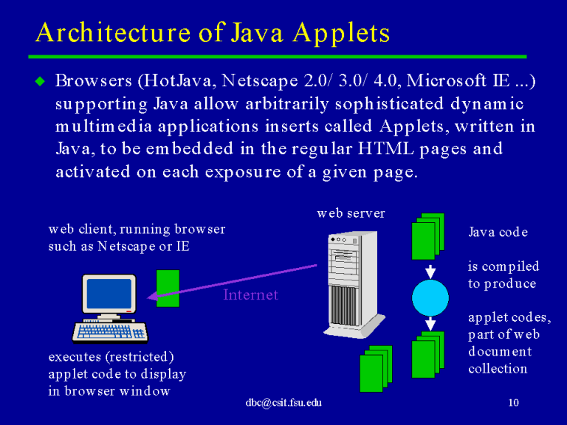

Slide 14
Applet Security Basics
Applets loaded over the network are usually considered to be untrusted code.
The only way to be sure that an untrusted applet cannot perform any malicious actions is to run it in a tightly controlled environment.
applets downloaded from a network or remote sources are considered untrusted. An applet can be considered trusted, based on the following factors:
Applets installed on a local filesystem or executed on a localhost.
Signed applets provide a way to verify that the applet is downloaded from a reliable source and can be trusted to run with the permissions granted in the policy file.

